Slide 1
IE 362 Lecture 2: Implementing Class with Diagram
Il-Chul Moon
Department of Industrial and Systems Engineering
KAIST

Slide 2
Short recap

Slide 3
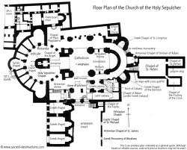
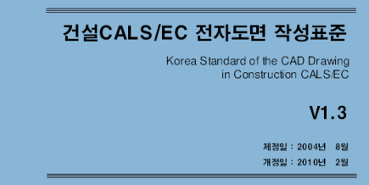
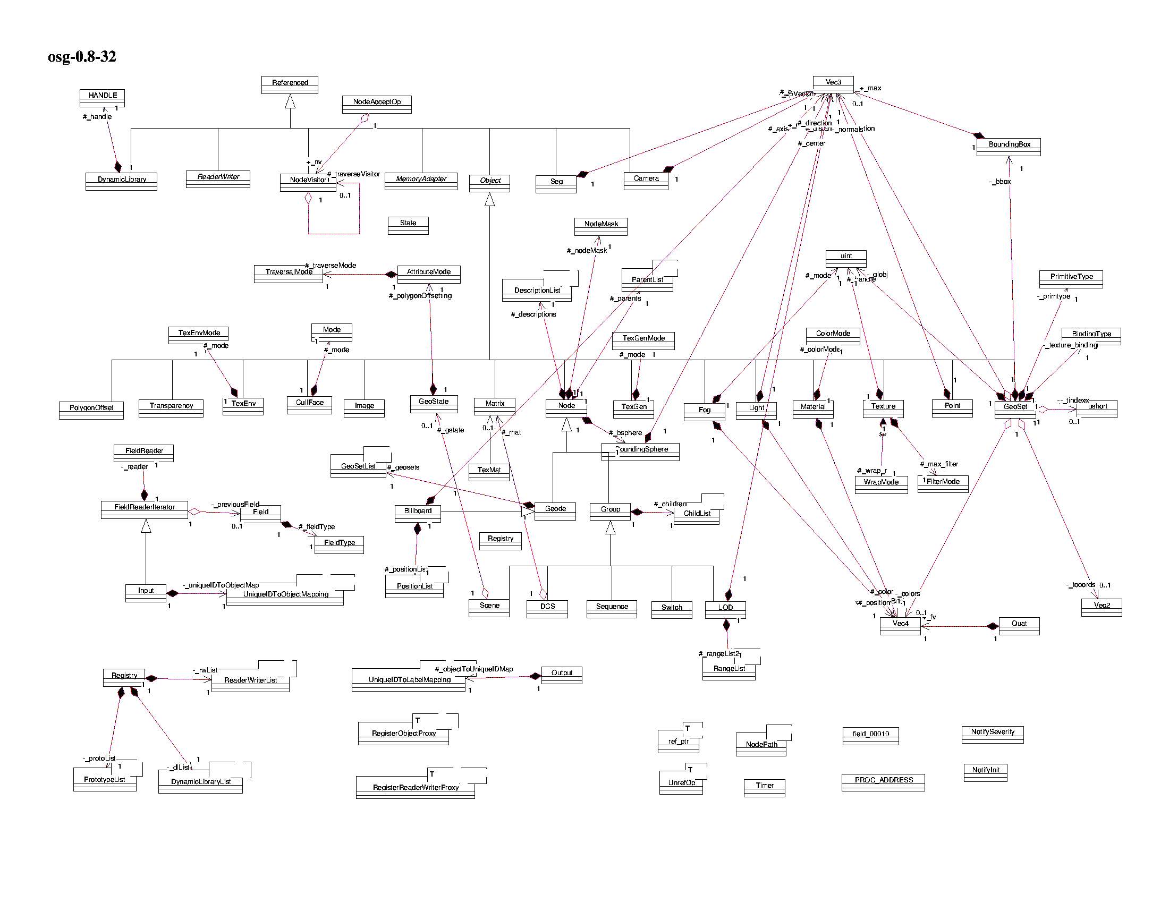

Software Design as House Floorplan
After your graduation, some of you will be constructors of software
Mainly design
Some coding
Need to learn how to communicate your colleagues
Learn standard
Learn how to represent your design to your boss
In software engineering,
UML is the standard

Slide 4
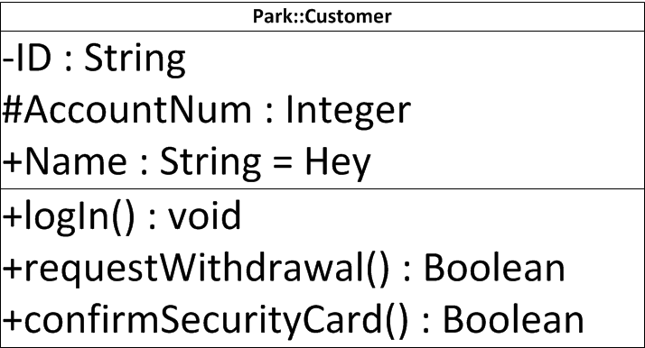
UML notation : Class and Instance
Abstract class
Class
Named instance
Unnamed instance
Person
Customer
Park::Customer
:Customer
Instance Name
Class Name
Member variables
+-#(name):(type)=(default value)
Visibility options
+ → public
# → protected
- → private
Methods
+-#(name)(arguments):(type)

Slide 5
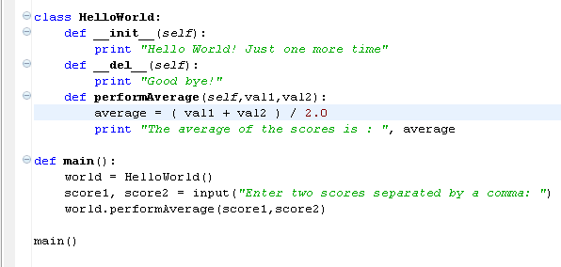
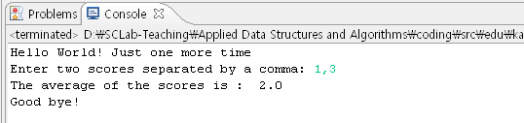
Python Program Structure - Another Hello World
Your second Python program in this class
Object-oriented program
HelloWorld is an object
__init__, __del__, and performAverage are methods
Largely in two parts
Definition part
Execution part

Slide 6
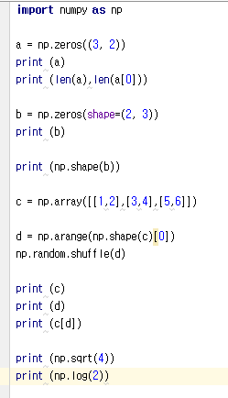
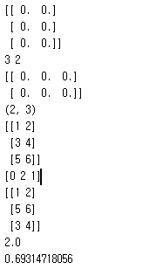
Additional Knowledge for Exercise

Slide 7
Offline class plan

Slide 8
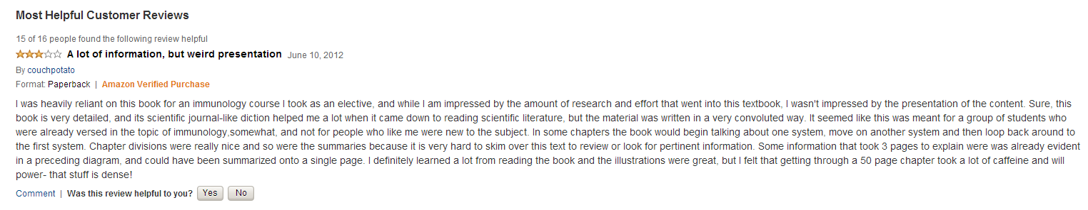
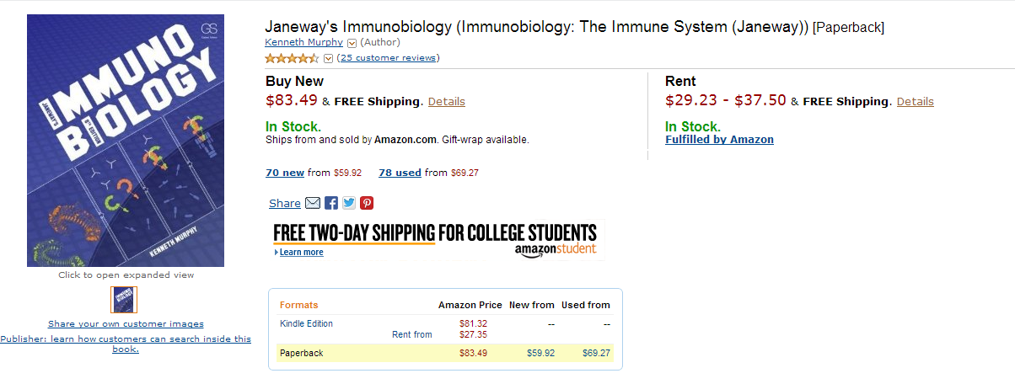
Product Review and Sentiment Analysis
Objective
Make the complete analysis: calculate the analysis accuracy
Use the attribute of classes
Make the charts
Problem 1. runAnalysis
Complete the if-then statements to count the accuracy of analysis
Problem 2. runWholeAnalysis
Complete the for loop and the related codes to run the analysis for the entire testing set.
Problem 3. runExperiments
Complete the for loop to calculate the averages and the standard deviations
Calculate the average and the standard deviations

Slide 9
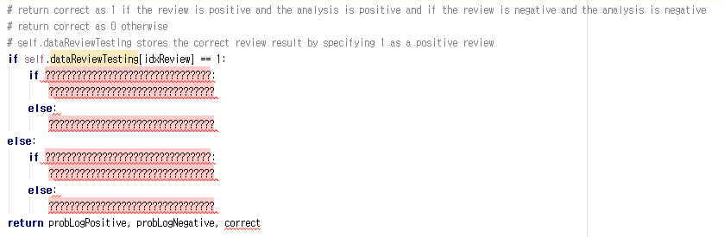
Problem 1. runAnalysis
Find how to determine the correct case for a single trial

Slide 10
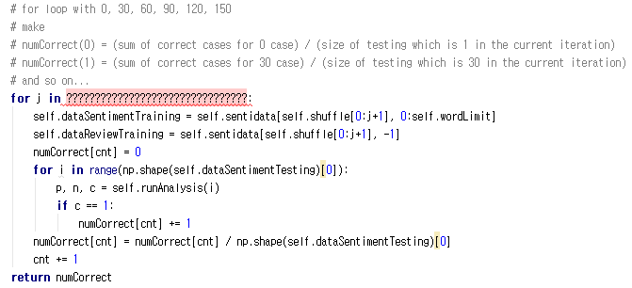
Problem 2. runWholeAnalysis
Find how to count the correct case for multiple trials
You need to count the correct cases
You need to store the count
Vary the training dataset size
By looping with 30 case interval
Create the training size as “j”

Slide 11
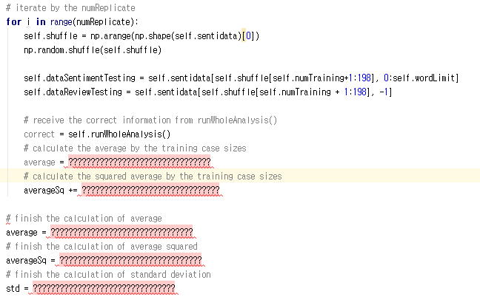
Problem 3. runExperiments
Find how to calculate the average performance and the confidence interval
Calculating the standard deviation with a single pass of a loop

Slide 12
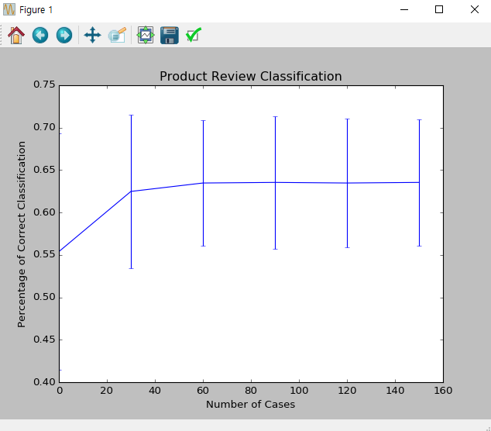
Execution Result
When you complete the codes, you are expected to see the below results.
But, the chart might not look same

